Slide 1
Install software
Install MySQL server
https://dev.mysql.com/downloads/mysql/
Install MySQL Workbench
https://dev.mysql.com/downloads/workbench/
For Windows user
Install MSI Installer, contains MySQL server and MySQL Workbench
https://dev.mysql.com/downloads/windows/installer/8.0.html

Slide 2
food(fid:int, fname:varchar(45) not null)
ingredient(iid:int, iname:varchar(45) unique)
recipe(amount:varchar(10), fid:int, iid: int)

Slide 3
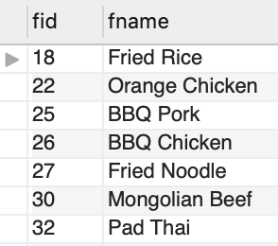
Food Table
SQL Statements
create table food (
fid int,
fname varchar(45) not null,
primary key(fid));
INSERT INTO `food` VALUES
(18,'Fried Rice’),
(22,'Orange Chicken’),
(25,'BBQ Pork’),
(26,'BBQ Chicken’),
(27,'Fried Noodle’),
(30,'Mongolian Beef’),
(32,'Pad Thai’);
food(fid:int, fname:varchar(45) not null)

Slide 4
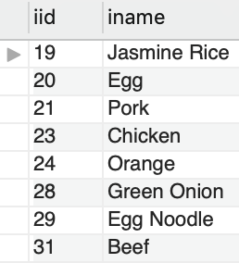
Ingredient Table
SQL Statements
create table ingredient(
iid int,
iname varchar(45) unique,
primary key(iid));
INSERT INTO `ingredient` VALUES
(19,'Jasmine Rice'),(20,'Egg’),
(21,'Pork'),(23,'Chicken’),
(24,'Orange’), (28,'Green Onion’),
(29,'Egg Noodle'),(31,'Beef’);
ingredient(iid:int, iname:varchar(45) unique)

Slide 5
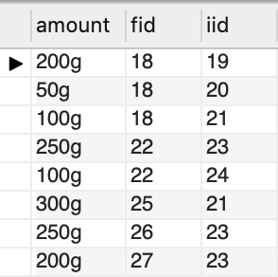
Recipe Table
SQL Statements
create table recipe (
amount varchar(10),
fid int,
iid int,
primary key(fid,iid),
foreign key(fid) references food(fid),
foreign key(iid) references ingredient(iid));
INSERT INTO `recipe` VALUES
('200g',18,19),('50g',18,20),
('100g',18,21),('250g',22,23),
('100g',22,24),('300g',25,21),
('250g',26,23),('200g',27,23);
recipe(amount:varchar(10),
fid:int, iid: int)

